Slide 1
Modeling Pedestrian Flow in a Crowded Building
Battista P., Ferradini C. A., Biella A., Fioroni L., Guillement V.

Slide 2
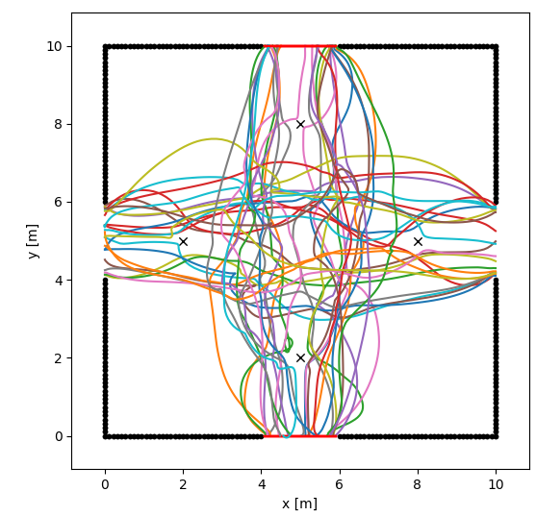
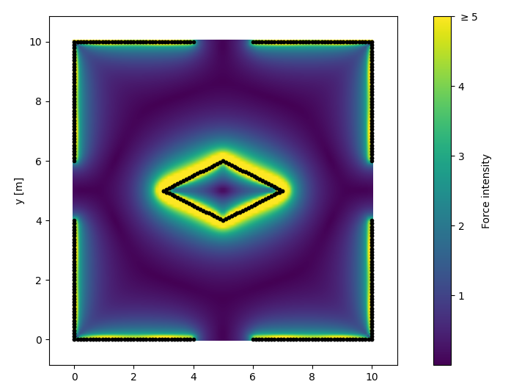
Introduction & Goal

Slide 3

Agents

Slide 4

Agents

Slide 5
Environment

Slide 6
Simulation

Slide 7
Problems and Difficulties

Slide 8
Evaluation

